Slide 1
How We're Transforming Our AFP Chapter Through a Commitment to IDEA
Presented by: Elise Christmon, Valerie Sipp,
Edna Meza-Aguirre, CFRE, JD, Julie Ragland, and Anton Russell

Slide 2
Land Acknowledgement
We acknowledge and pay tribute to the original inhabitants of this land. The city of New Orleans is a continuation of an indigenous trade hub on the Mississippi River, known for thousands of years as Bulbancha. Native peoples have lived on this land since time immemorial, and the resilient voices of Native Americans remain an inseparable part of our local culture. With gratitude and honor, we acknowledge the indigenous nations that have lived and continue to thrive here.

Slide 3
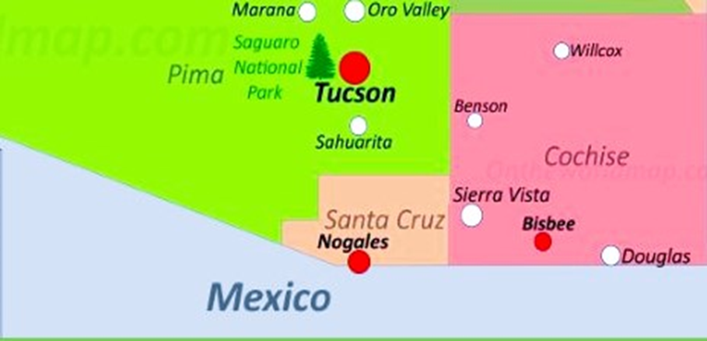

Slide 4
Mission statement: Advancing philanthropy through
education, training, and advocacy
Vision statement: Association of Fundraising Professionals
Southern Arizona advances fundraising careers, connects
members to a community of support, and educates nonprofit
professionals on best practices and ethical standards in
fundraising

Slide 5
Diversity
Our Chapter defines diversity as our commitment to celebrate our members, volunteers, officers, directors, agents, contractors, and others with whom we interact, regardless of age, color, disability, ethnicity, family or marital status, gender identity or expression, language, national origin, physical and mental ability, race, religion, sexual orientation, veteran status, and other characteristics that make them unique. (So Az AFP board resolution 1.27.23)

Slide 6
IDEA
AFP is committed to the principles of inclusion, diversity, equity and access (IDEA) in the fundraising profession, the philanthropic sector and throughout all of society.
(AFP Global 2023)

Slide 7
Safe Space
noun; A place intended to be free of bias, conflict, criticism, or potentially threatening actions, ideas, or conversations
(2023 Merriam-Webster)

Slide 8
The Hard Truth
New voices and perspectives. Means more than just getting BIPOC people in the room. Representation and diversity takes many shapes.

Slide 9
Inclusion BEFORE Diversity
Action Item: If you are a Governing Board member, establish an Executive Director with an equity mindset & if you are an Executive Director establish an equitable Governing Board.
With leadership in place, analyze EVERYTHING! Bylaws, Policies, Conflicts of Interests, Employee Handbook, Compensation & Benefits, Mental Health sick days, kids coming to work, burnout…EVERYTHING!

Slide 10
Top-Down Before Bottom-Up
Equity minded leadership is essential to encourage folx to share their experiences aka field notes.

Slide 11
People BEFORE Policy
Approach harmful situations with less degree “what happened?” & all degree “how do you feel about ___?” or “are you feeling like this is a safe & inclusive space for you?”
Concern yourself with knowing the sensation of alienation vs isolation
Always be prepared to confront your investors who may feel entitled & therefore resistant to change (remember alienation vs isolation, cancel culture, etc.)

Slide 12
CELEBRATE!
Share your personal growth opportunities as a leader, while being careful not to retraumatize those who were impacted.
Highlight important relationships in your community of individuals who built a bridge of understanding between opposites.

Slide 13
CELEBRATE! (cont.)
Gather your entire community together regularly around the passion of your organization. Find creative ways to get folks to mix with each other to help drop the walls between them.
Communicate & model an open-door policy. GET IN to the work of assistants, coordinators, managers & other directors in your organization to realize how your policies are impacting them.

Slide 14
Common Mid-Range Roadblocks
No one-size-fits-all roadmap
Solid team a must
Bumpiness when things actually have to change

Slide 15
Pressure to progress work
Performativity
Need results/metrics
How do we know we’re becoming less racist?
Checking boxes out of fear
No inner or systemic change

Slide 16
Pressure on Leadership
You will need to direct resources to IDEA work and staff
Invest in longevity and retention for culture to thrive
Don’t rush your timeline
Slow down and regroup/pivot if you need
It’s about the process and culture you create
Results and success are unique to your organization

Slide 17
Pressure on BIPOC Staff
Navigating the power dynamics of fundraising while dealing with the reality of how systemic racism plays out in our orgs
We have less money and inherited wealth = less security, taking fewer risks
Pioneer work is hard - for whose benefit? Who gets paid to do this “mission critical” work? Who looks good for sticking their neck out?

Slide 18
Burnout
BIPOC staff
Consider taking a step back
Are you enabling white fragility?
Put your oxygen mask on first
Leadership
Dedicate time and space for processing
Affinity groups are excellent
Lean on outside resources (like AFP!)

Slide 19
Call to Action - WHO
Anyone with power and/or privilege, especially
White people
People with intergenerational wealth
People with influence
All entities:
Non-profit organizations
Businesses/corporations
Affiliate organizations (i.e. AFP chapters)

Slide 20
Call to Action - WHAT
Make an EXPLICIT commitment to IDEA
Individually this may mean defining your personal VALUES and making a commitment to explore and talk about IDEA with your circles even if it’s not easy or comfortable
Collectively/Organizationally this may include developing an IDEA commitment statement, defining your organizational VALUES, and making a commitment to explore and talk about IDEA together even if it’s not easy or comfortable

Slide 21
Call to Action - WHAT
Consider IDEA your “NORTH STAR” when it comes to action, and the lens through which everything is viewed.
Ask: “If our value is ______________, then our aligned action should be ____________________.”
Ask: “If we are using an IDEA lens to view this situation, what additional perspectives and voices might be missing?”

Slide 22
Call to Action - HOW
Build IDEA CULTURE
Values
Language & communication
Safe & brave spaces
Power & privilege dynamics
Build SYSTEMS & STRUCTURE to support that culture
Processes, policies, procedures

Slide 23
Call to Action - HOW
Build AUTHENTIC RELATIONSHIPS based on SAFETY, TRUST, and BELONGING.
SAFETY is physical, psychological, emotional, and financial.
TRUST is impossible if safely doesn’t exist.
BELONGING cannot be accomplished without safety and trust.

Slide 24
Call to Action - HOW
Those of us with power & privilege must be willing to share and relinquish power and control.
Be willing to try things differently than they’ve been done before. Ask: “Why are we doing things this way?”
Ask: “What’s keeping us from changing the way this is done?”

Slide 25
Call to Action - HOW
Understanding insidious & often hidden nature of white supremacy & oppression. This means:
Looking critically & reflectively at our systems & culture
Looking critically & reflectively at ourselves individually and collectively
Be willing to learn and make mistakes
Give ourselves and others grace, patience, and forgiveness

Slide 26
Call to Action - WHERE & WHEN
Everywhere, all at once!

Slide 27
Inclusion
Creating opportunities for new people to get involved by developing new approaches to traditional systems.

Slide 28
Diversity
New voices and perspectives. Means more than just getting BIPOC in the room. Representation and diversity takes on many shapes and forms.

Slide 29
Equity
Instead of equality. It is recognizing that power imbalances exist in the systems and cultures we all live and work in, and actively combating them to create equality.

Slide 30
Access
When you find yourself in important spaces or sitting at important tables, recognizing who is not in the room. Use your own privileges to identify barriers and create access for those who are missing. Access refers not only to physical access but also access to power, resources, and information.

Slide 31
Reach Out
Feel free to reach out to any of us if you have questions, are interested in resources, or want to know more about anything discussed today
Elise Christmon : sechristmon@gmail.com
Valerie Sipp : valerie.sipp@gmail.com
Edna Meza-Aguirre, CFRE, JD : emacananea@yahoo.com
Julie Ragland: julieragland@live.com
Anton Russell : anton@thedrawingstudio.org

